Slide 1
Chess Game
By\
Amr Eledkawy Ibrahim Shawky
Ali Abdelmoaty
Amany Hussam Amel Mostafa

Slide 2
PEAS
Performance
  winning the Game
Environment
  Chess pieces in chess board
  Adversary
Actuators
  Screen
Sensor
  Camera
  mouse

Slide 3
ODESA D
Observable
  Fully observable
Deterministic
  Strategic
Episodic
  Sequential
Static
  Semi dynamic
Agent
  Multi agent
Discrete
  discrete

Slide 4
Formulation
State
  Move chess parts to eat computer parts untle Besieging king
intial state
  Any state
Successor function
  Top , Down , Left , Right , diagonal
Goal
  King die
Path cost
  Time , each step cost 1

Slide 5
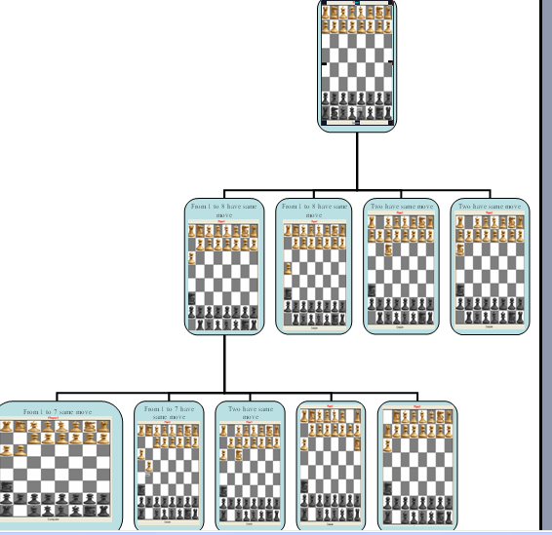
Tree
Two level from the tree but second level is a sample

Slide 6
Searching algorithm
We have two Searching algorithm
  Minmax algorithm
  Minimax is an algorithm used to determine the score in a zero-sum game after a certain number of moves, with best play according to an evaluation function.
  The algorithm can be explained like this: In a one-ply search, where only move sequences with length one are examined, the side to move (max player) can simply look at the evaluation after playing all possible moves. The move with the best evaluation is chosen. But for a two-plysearch, when the opponent also moves, things become more complicated. The opponent (min player) also chooses the move that gets the best score. Therefore, the score of each move is now the score of the worst that the opponent can do.

Slide 7
Searching algorithm
Alpha–beta pruning algorithm
  Alpha-Beta Heuristic [1] ) is a significant enhancement to the minimax search algorithm that eliminates the need to search large portions of thegame tree applying a branch-and-bound technique. Remarkably, it does this without any potential of overlooking a better move. If one already has found a quite good move and search for alternatives, onerefutation is enough to avoid it. No need to look for even stronger refutations. The algorithm maintains two values, alpha and beta. They represent the minimum score that the maximizing player is assured of and the maximum score that the minimizing player is assured of respectively.

Slide 8
Minmax algorithm
function minimax(node, depth, maximizingPlayer)
if depth = 0 or node is a terminal node
return the heuristic value of node
if maximizingPlayer
bestValue := -∞
for each child of node
val := minimax(child, depth - 1, FALSE)
bestValue := max(bestValue, val)
return bestValue
else
bestValue := +∞
for each child of node
val := minimax(child, depth - 1, TRUE)
bestValue := min(bestValue, val);
return bestValue
(* Initial call for maximizing player *) minimax(origin, depth, TRUE)

Slide 9
Alpha–beta pruning algorithm
function alphabeta(node, depth, α, β, maximizingPlayer)
if depth = 0 or node is a terminal node
return the heuristic value of node
if maximizingPlayer
for each child of node
α := max(α, alphabeta(child, depth - 1, α, β, FALSE))
if β ≤ α
break (* β cut-off *)
return α
else
for each child of node
β := min(β, alphabeta(child, depth - 1, α, β, TRUE))
if β ≤ α
break (* α cut-off *)
return β
(* Initial call *) alphabeta(origin, depth, -∞, +∞, TRUE)

Slide 10
How to reach us
Face book
  https://www.facebook.com/chessteamgo
Blogger
  http://chessteamgo.blogspot.com/
Source forage
  https://sourceforge.net/projects/chessteam/
Dr.el-dosuky
  http://www.el-dosuky.com/teach_team.php?cors=ai_14&tm=08

